Slide 1

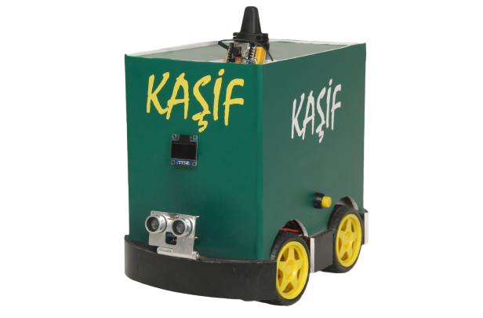

Autonomous Vehicle
KAŞİF UGV

Slide 2
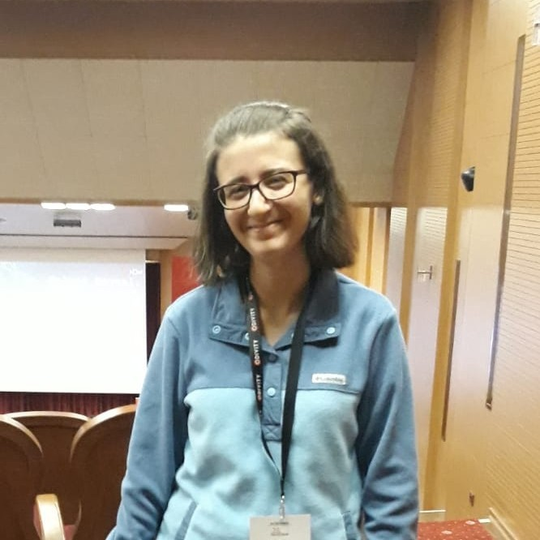


OUR ADVISOR
DR. SERDAR ARSLAN
OUR TEAM
EYLÜL ERDOĞAN
ALİ BOZDOĞAN
ALEYNA DEDE
201711025
201717009
201711019

Slide 3
TABLE OF CONTENTS
01
02
03
04
05
06
PROJECT DEFINITION
MAIN FEATURES
KAŞİF ANDROID APP
OPERATING MODES
OBJECT DETECTION
THREATS DETECTION
07
08
09
REPORTS OF THREATS
GPS TRACKING
QUESTIONS

Slide 4
PROJECT DEFINITION
In our project, it is aimed to develop national unmanned ground vehicle which acts as a spy or guardian of a field.
Therefore, our vehicle is not only self-driving car, it has 5 additional features which will be explained in next sections.

Slide 5
MAIN FEATURES
01
02
03
KAŞİF APP
Operating Modes
Object Detection
04
05
06
Threat Detection
Report of Threats
GPS Tracking

Slide 6

KAŞİF ANDROID APP
KAŞİF can be controlled via KAŞİF Android App.
This application is written by using Java programming language.

Slide 7

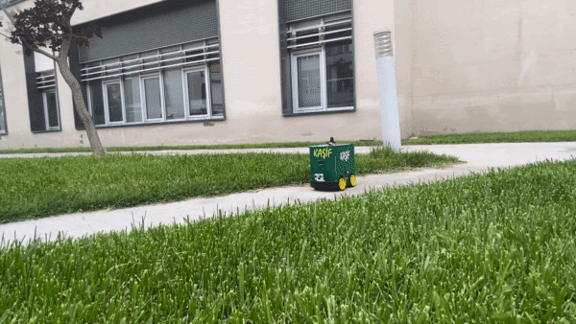
OPERATING MODES
AUTONOMOUS MODE
MANUAL MODE
When autonomous button on app is pressed, vehicle will start to operate without any human intervention.
With direction buttons, KAŞİF can be operated.
For that purpose, we used Arduino Uno board and HC05 Bluetooth module.

Slide 8

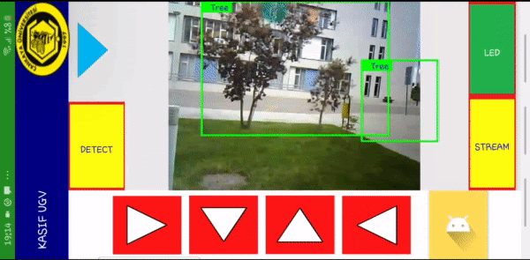
OBJECT DETECTION
We trained a Tensorflow Lite model with YOLO algorithm to be able to detect objects.
In this model, there are 600 different objects.

Slide 9

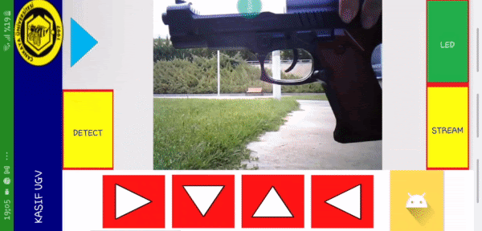
THREAT DETECTION
Among these 600 different objects, there are 17 military-based objects.
When application detects a threat, red box appears at the around of that object.
A warning sound which says “Threat is detected” can be heard.

Slide 10
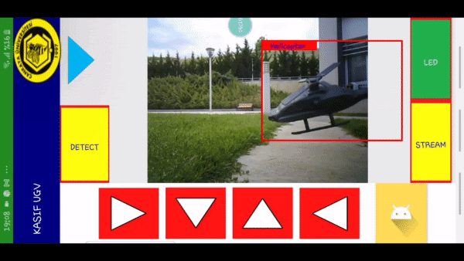
LIST OF THREATS
Missile
Sword
Shotgun
Weapon
Rocket
Bomb
Remote control
Airplane
Helicopter
Handgun
Rifle
Tank
Skull
Land vehicle
Watercraft
Dagger
Knife

Slide 11
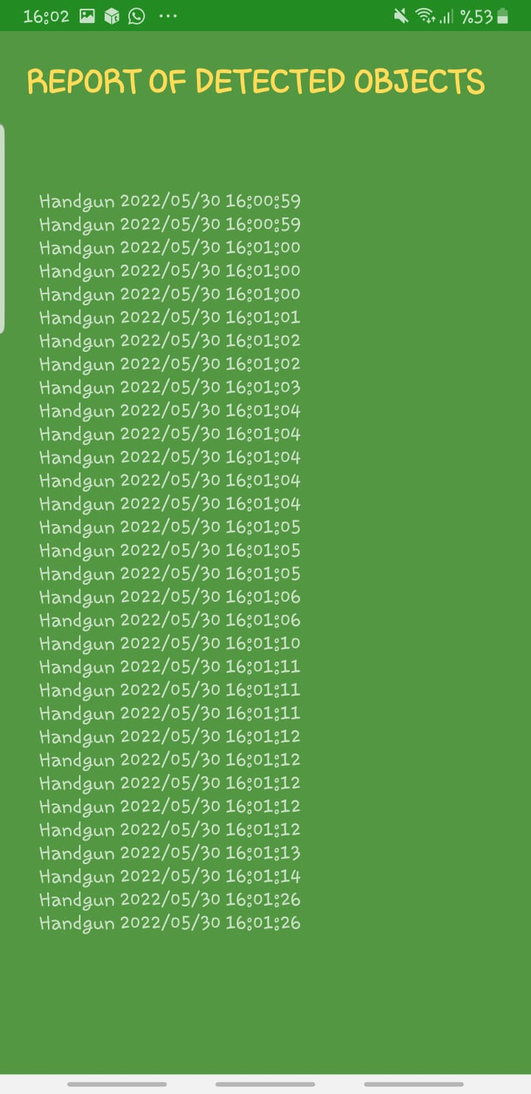


REPORTS OF THREATS
When user wants to observe these detections, s/he can use blue triangle button and see the reports screen.

Slide 12
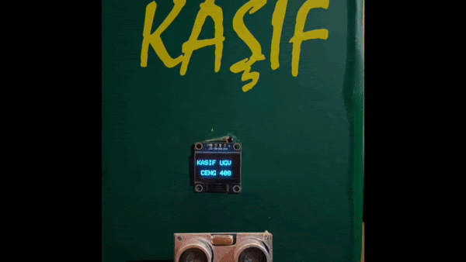

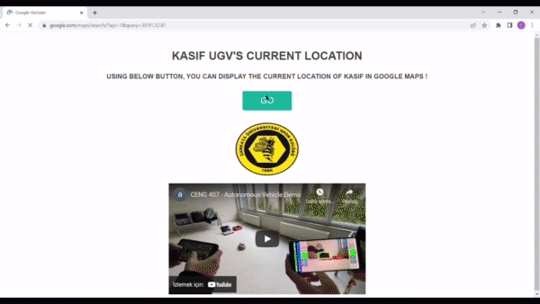
GPS TRACKING
With ESP8266 module we developed a GPS tracking model. For that purpose, we used an additional OLED screen to be able to display results and create a webserver to provide results on Google Maps.

Slide 13
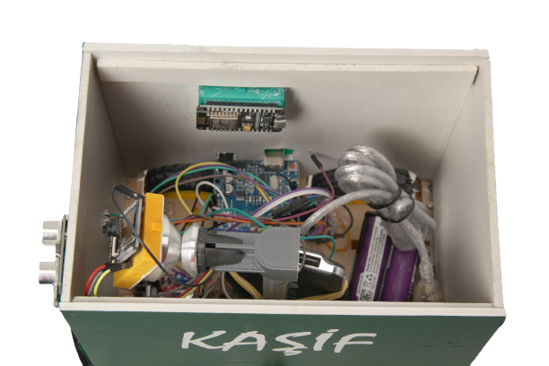
THANK YOU!
QUESTIONS?

